Slide 2
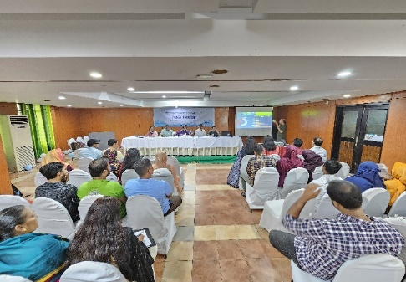
Project
Support for Enhancing Accountability in Water and Sanitation Sector to address risks of WASH Project
This Project has been started since January 2024 with the support of German Based Water Integrity Network (WIN).
www.wavefoundationbd.org

Slide 3
Outcomes from Lobby & Advocacy- Initiatives taken by RWASA
1
Citizen Charter of Rajshahi WASA has been displayed in ward councilor offices
2
SMS notifications have been sent for water bill payments
3
Complaints box and Citizen Charter have been placed in front of the main gate of RWASA building
4
Collection of mobile numbers from customers without registered contact details is ongoing
5
To ensure timely delivery of water bills to customers, long-term vendors will be appointed.
6
During floods, information about water purification processes has been disseminated through WASA website
7
Public hearings are conducted with the People’s participation with professional groups

Slide 4
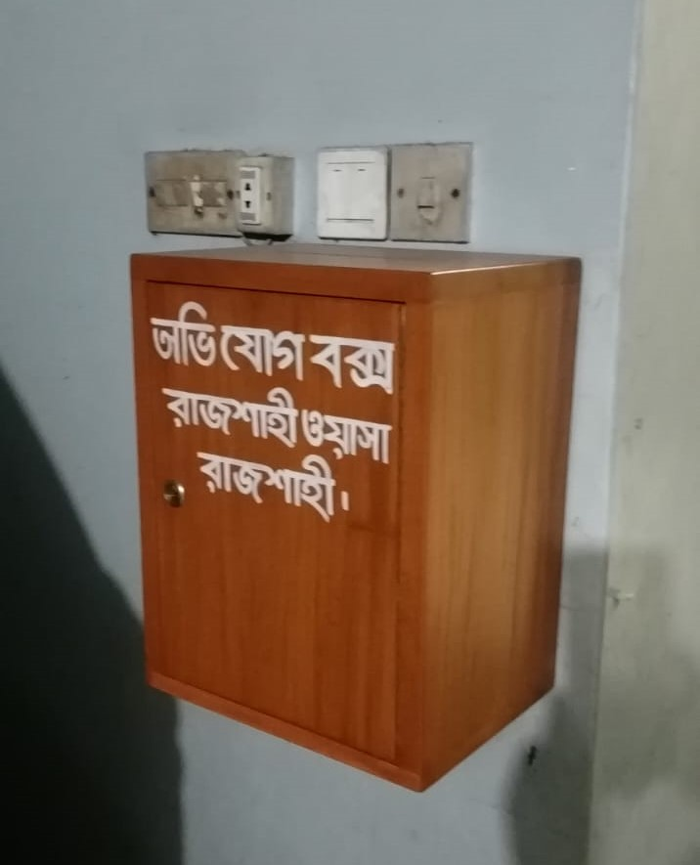
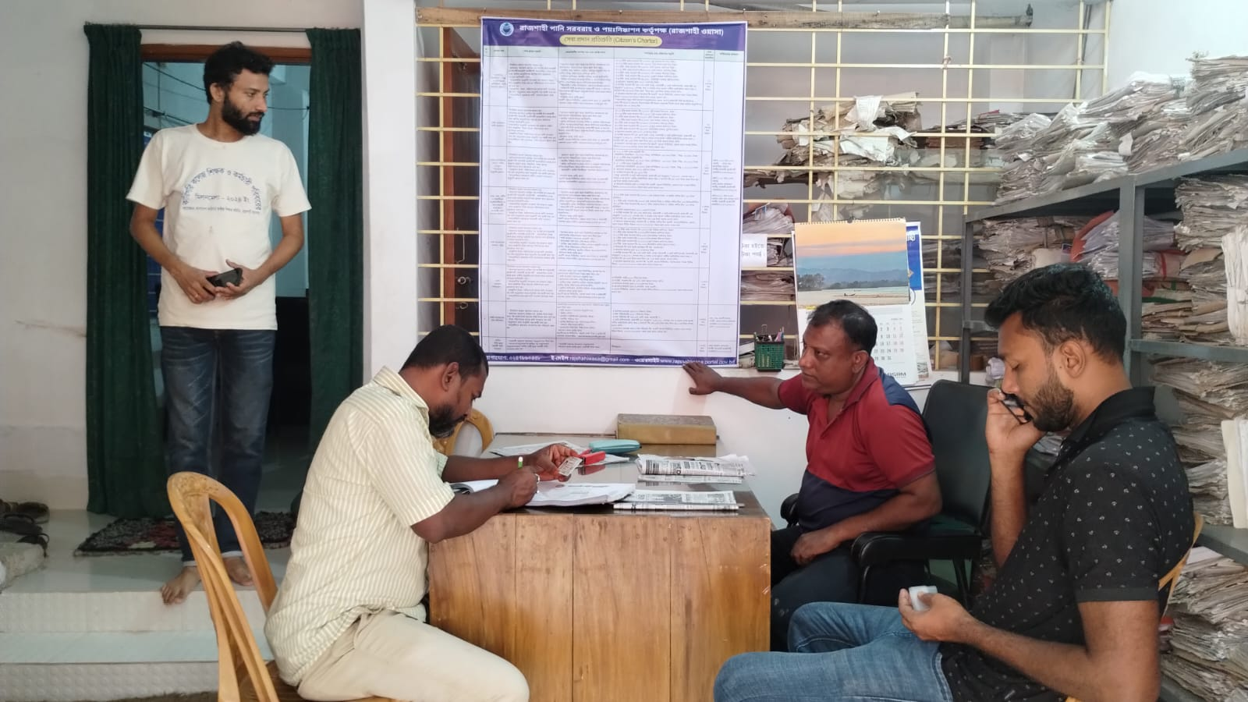
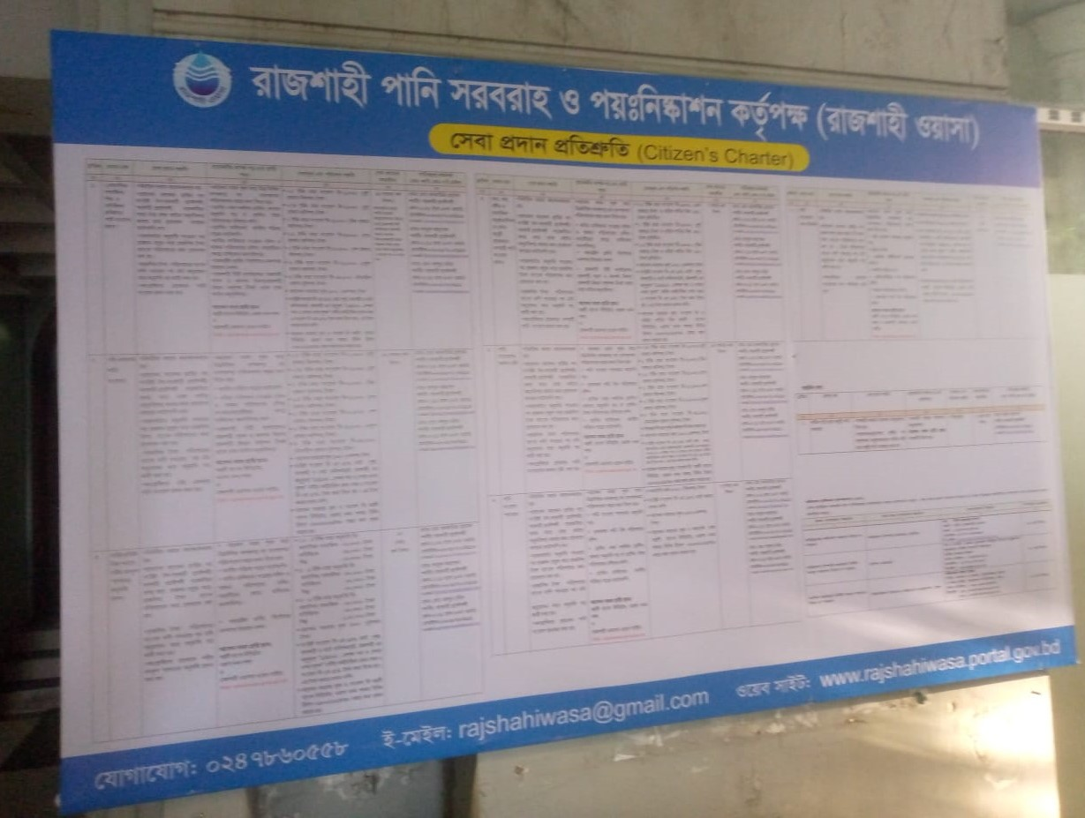
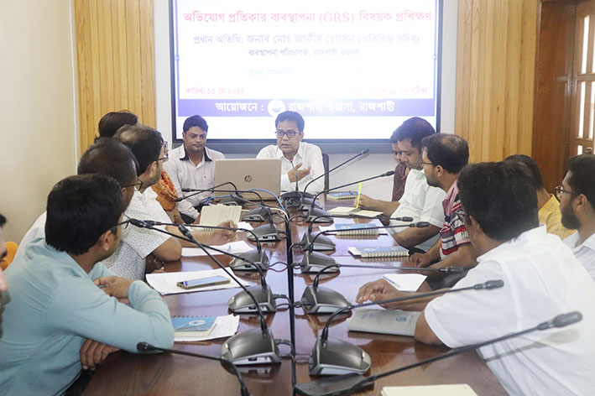
Outcomes from Lobby & Advocacy- Initiatives taken by RWASA

Slide 5
Outcomes from Lobby & Advocacy-Initiatives taken by KWASA
1
Meeting with NGO & other related representative at KCC
2
Display citizen charter at ward councilor office of KCC
3
Citizen Charter & information digital screen at Khulna WASA offices
4
Weekly public hearing notice distribution with water bills
5
Complain box at KWASA

Slide 6
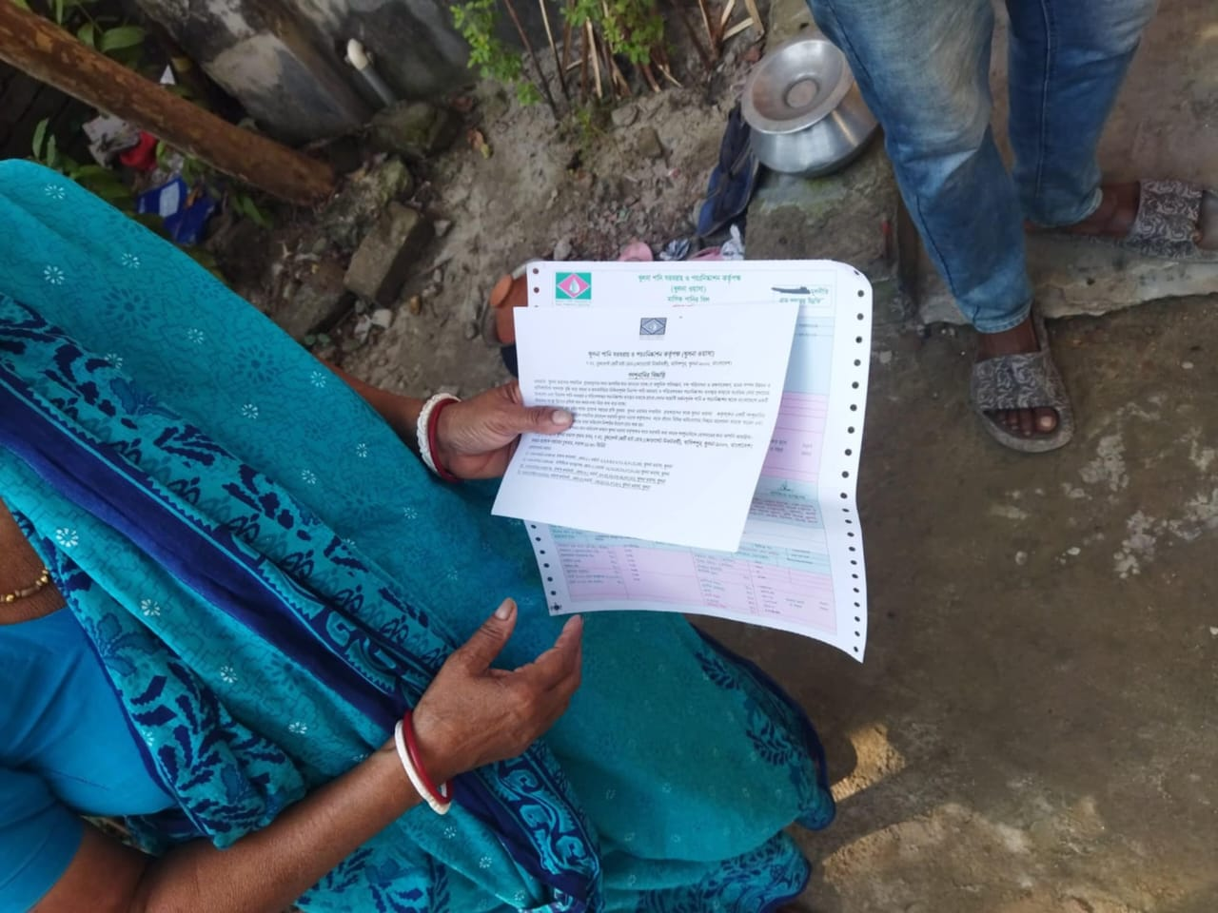
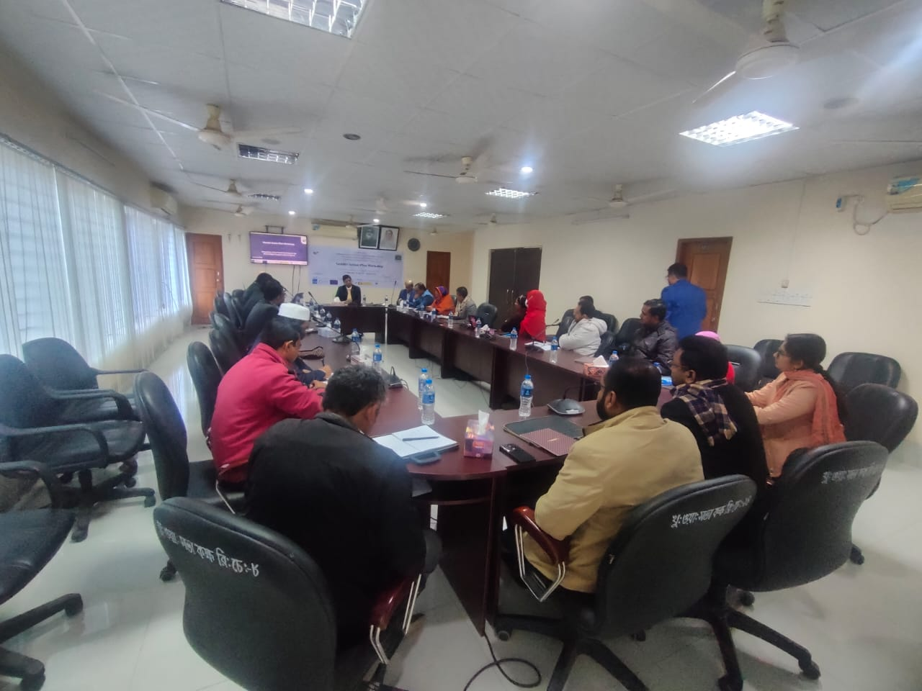
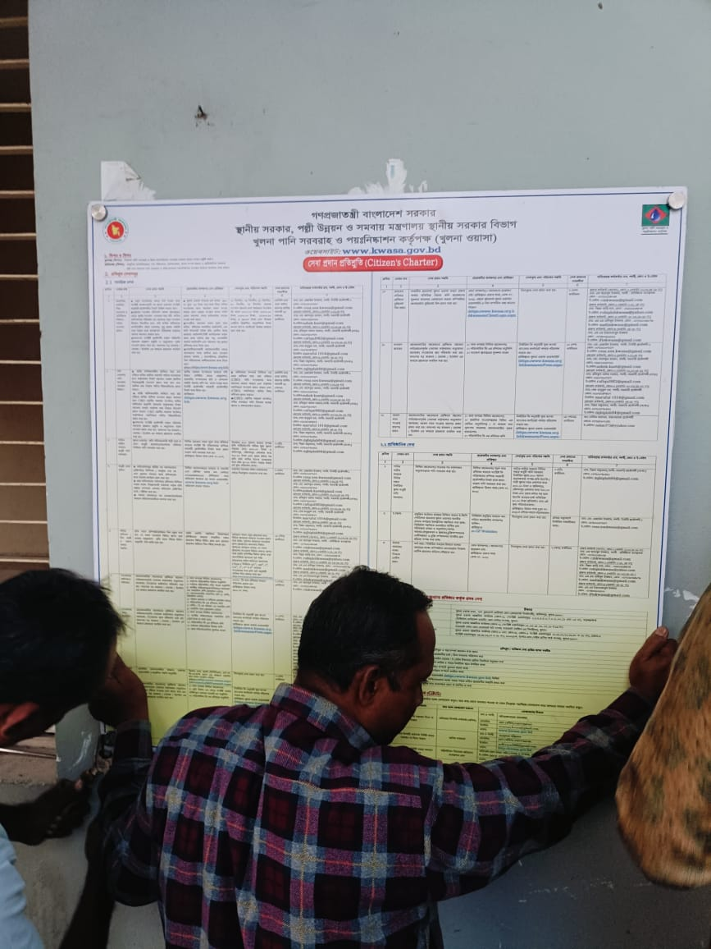
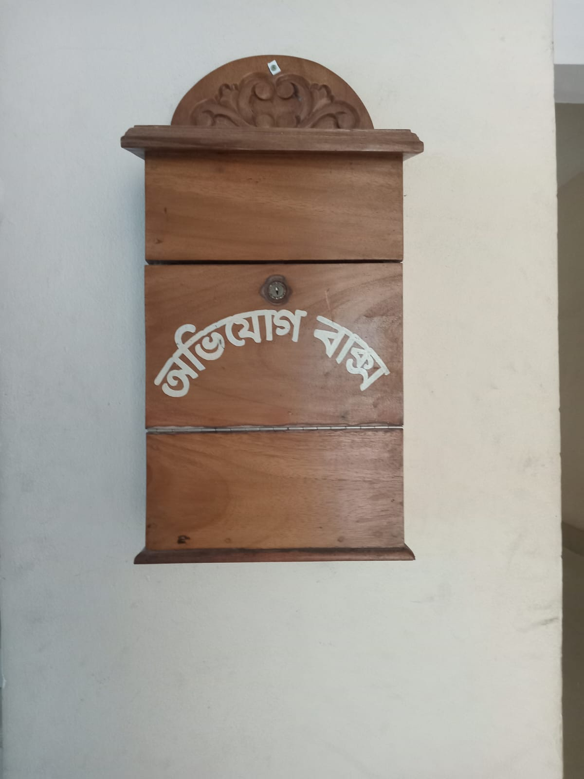
Outcomes from Lobby & Advocacy- Initiatives taken by RWASA

Slide 7
Robust Campaigns and Community-Based Awareness Programs
Increasing Coordination with WASH and other service Providing Authority
Recommendation
The Major
Components
Regularizing Citizen Consultations and Demand Driven Activities
Strengthening Civil Society Organizations and Community Engagement
www.wavefoundationbd.org

Slide 11
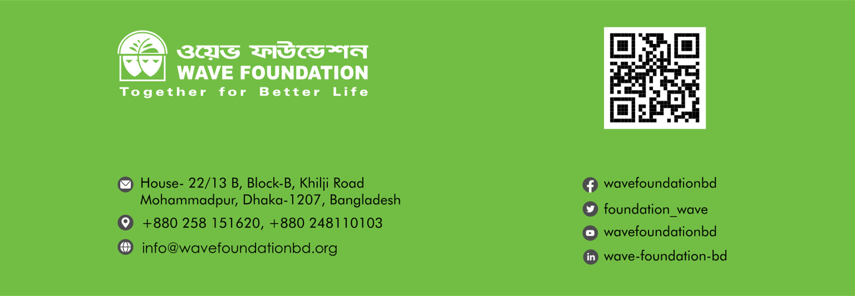
Thank you

